Slide 1
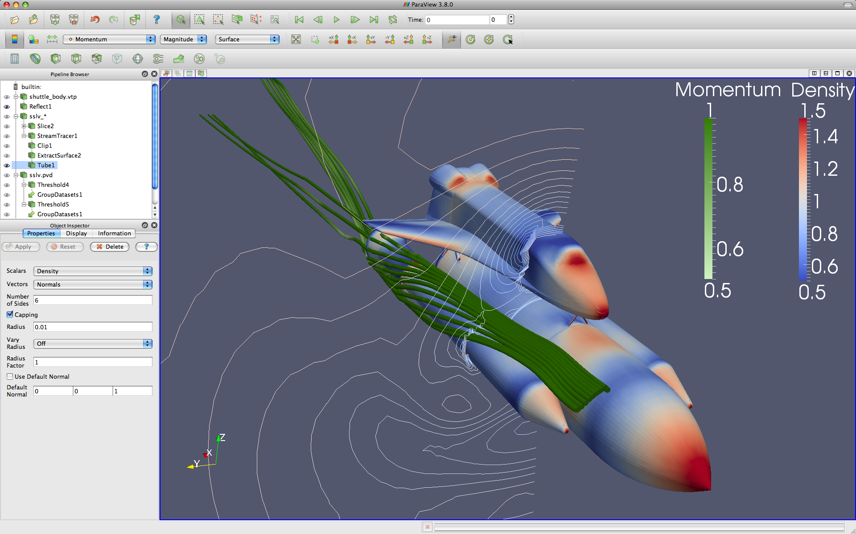
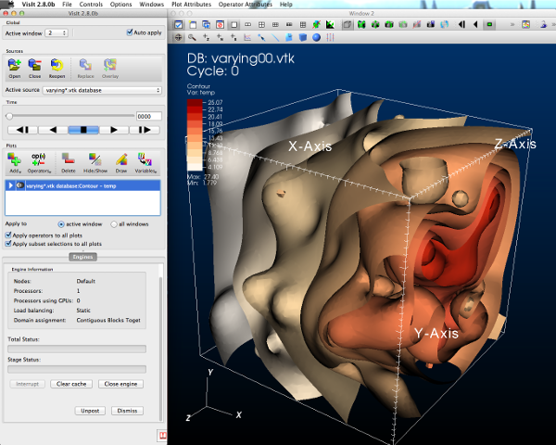



DOE Visualization Software
Cinema
Database
Support
ECP Annual Meeting
Kenneth Moreland Sandia National Laboratories
February 1, 2016

Slide 2



GUI / Parallel Management
In Situ Vis Library
(Integration with Sim)
Simulations
Base Vis Library
(Algorithm Implementation)
Libsim
Multithreaded Algorithms
Processor Portability
Flexible Data Models
Flyweight Integration
Cinema
Database
Support
Notes:
The basic software stack for the XVis project

Slide 3
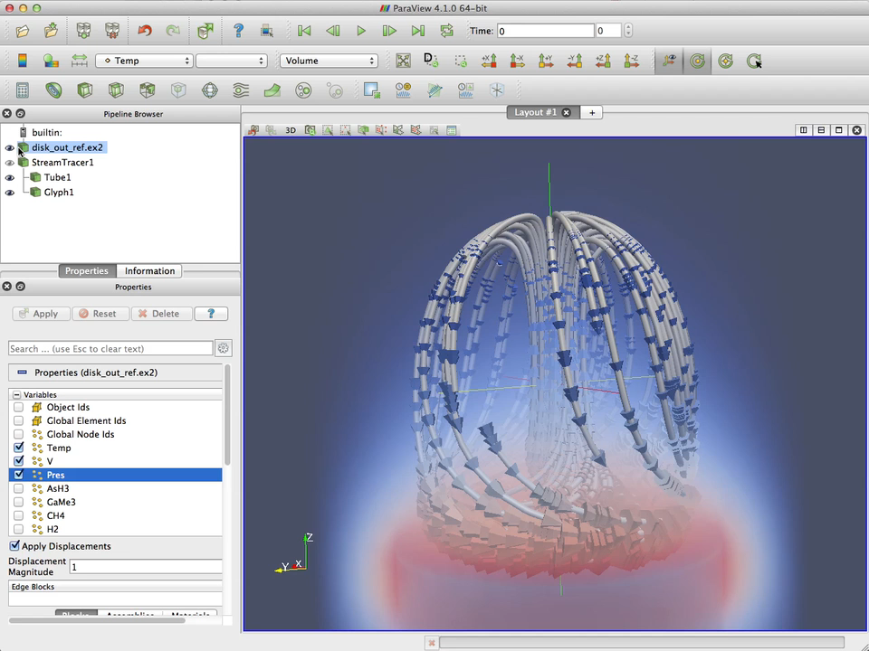
Notes:
What are ParaView and VisIt?

Slide 4
GUI / Parallel Management
In Situ Vis Library
(Integration with Sim)
Simulations
Base Vis Library
(Algorithm Implementation)
Libsim
Multithreaded Algorithms
Processor Portability
Flexible Data Models
Flyweight Integration
Cinema
Database
Support
Notes:
The basic software stack for the XVis project

Slide 5
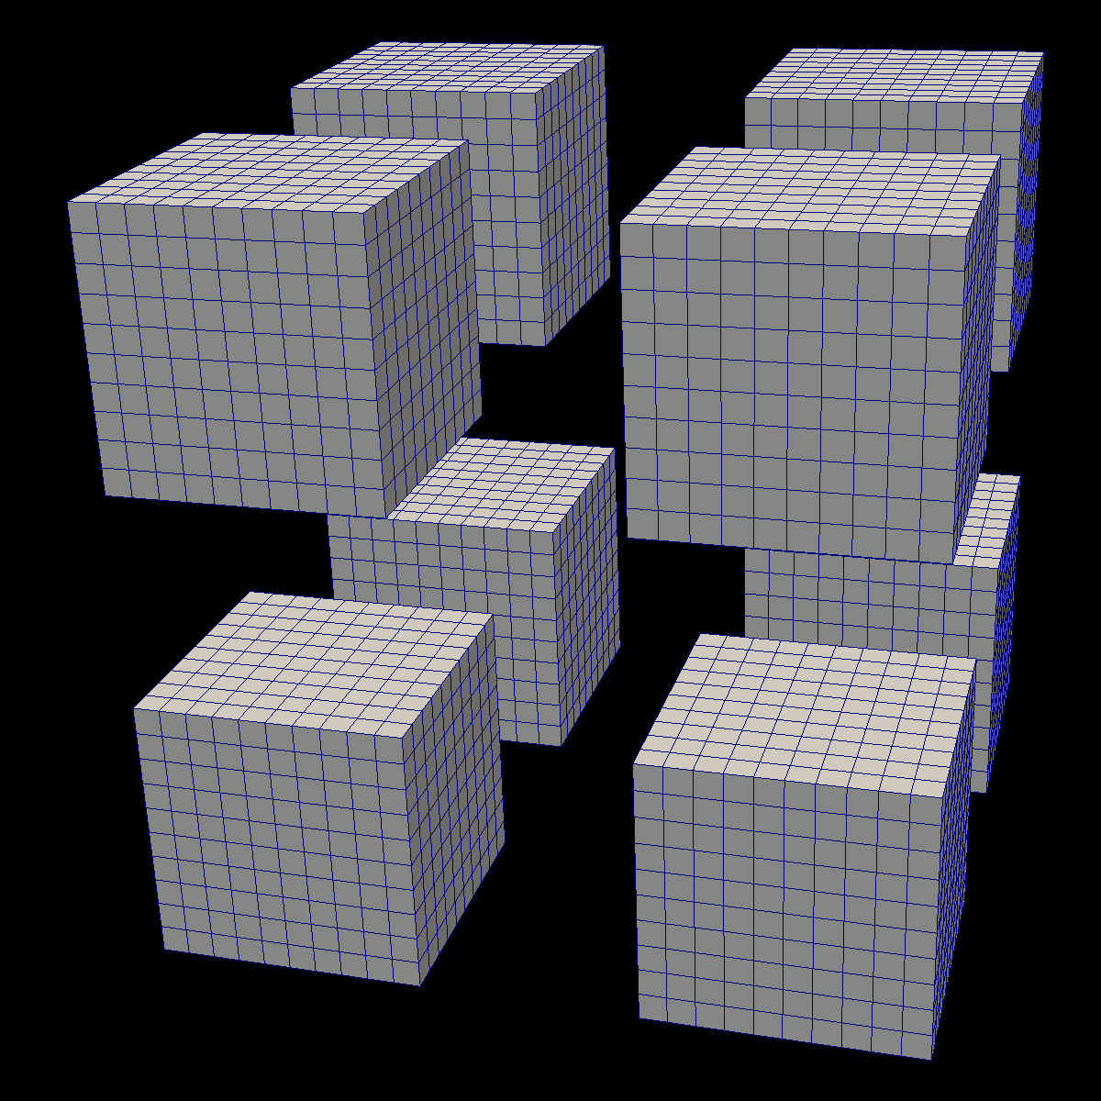
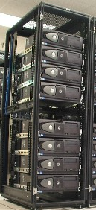
Inter-Node
Parallelism
DIY
Intra-Node
Parallelism
Notes:
What is VTK-m?

Slide 6
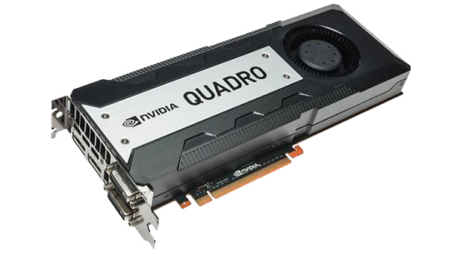
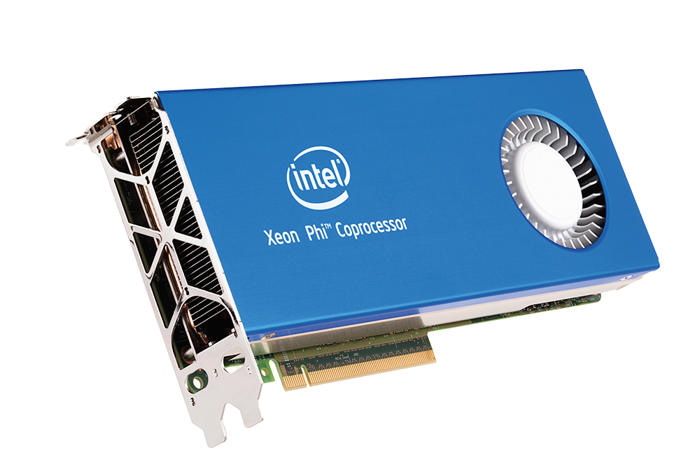
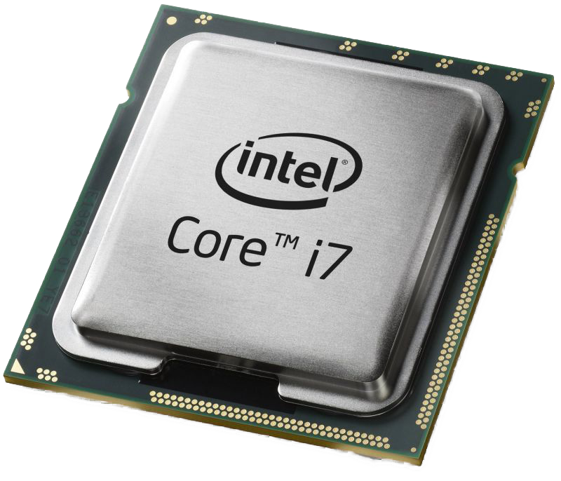
How Many Architectures to Support?
GPU (NVIDIA)
CPU/MIC
Sub-architectures:
Fermi, Kepler, Maxwell
Multiple Memory Types:
Global, shared, constant, texture
Memory Amount: Up to 12 GB
1000s of threads
Grids, blocks, and warps
Mulple ISAs:
Vector unit widths: 2,4,8 / 16
Single Memory Type
Except when not (cache, HSM)
Larger Memory Size
Up to 60/260 threads
No explicit organization

Slide 7
GUI / Parallel Management
In Situ Vis Library
(Integration with Sim)
Simulations
Base Vis Library
(Algorithm Implementation)
Libsim
Multithreaded Algorithms
Processor Portability
Flexible Data Models
Flyweight Integration
Cinema
Database
Support
Notes:
The basic software stack for the XVis project

Slide 8
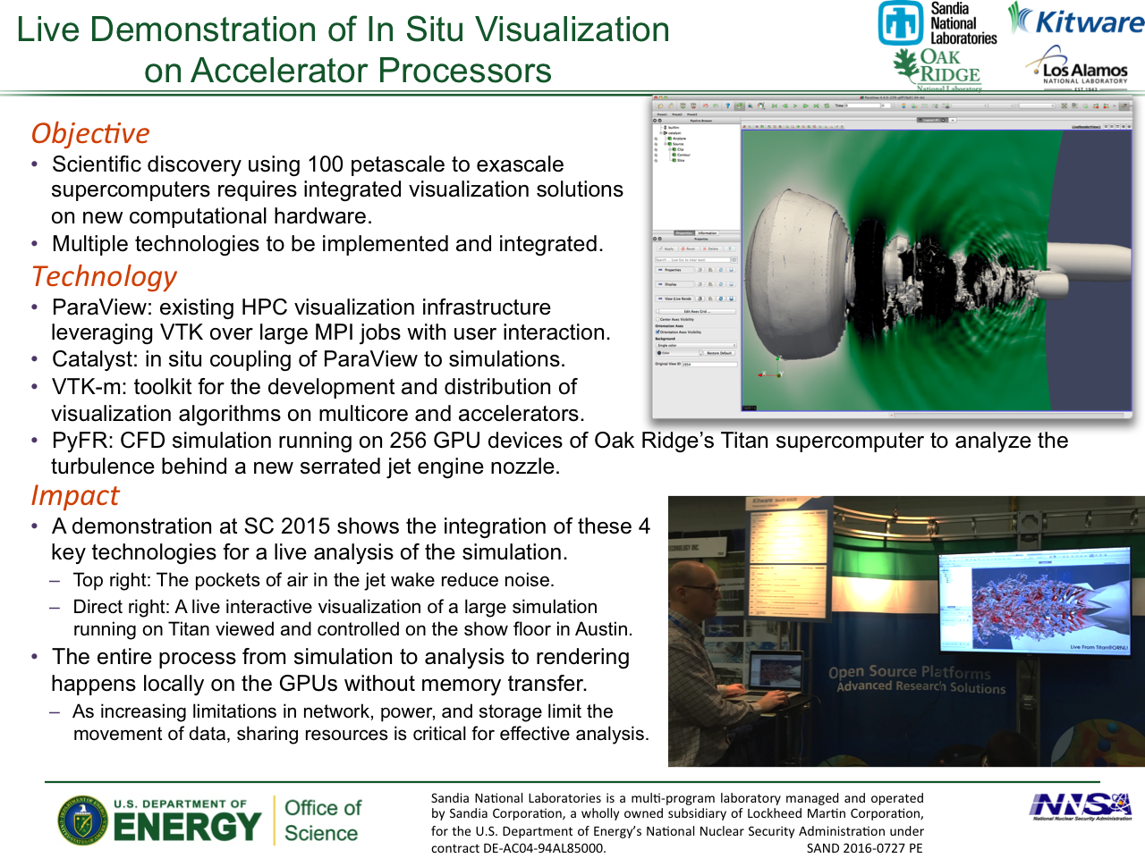

Slide 9


Acknowledgements
This material is based upon work supported by the U.S. Department of Energy, Office of Science, Office of Advanced Scientific Computing Research, under Award Numbers 10-014707, 12-015215, and 14-017566.
Sandia National Laboratories is a multi-program laboratory managed and operated by Sandia Corporation, a wholly owned subsidiary of Lockheed Martin Corporation, for the U.S. Department of Energy’s National Nuclear Security Administration under contract DE-AC04-94AL85000.
Lots of credit goes out to all our collaborators:
Chris Sewell, Jeremy Meredith, David Pugmire, Berk Geveci, Robert Maynard, Hank Childs, Kwan-Liu Ma, and many others.
http://m.vtk.org

